Slide 1
Flood fill algorithm

Slide 2
The purpose of Flood Fill is to color an entire area of connected pixels with the same color.
It's the Bucket Tool in many painting programs.
Here's an example: the original image is on the left.
Then a floodfill was started inside the large shape, and the algorithm gave all pixels inside the shape the new color, leaving its borders and the pixels outside intact.

Slide 3
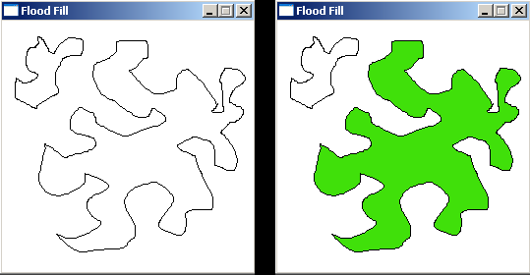

Slide 4
The Flood Fill algorithm is also sometimes called Seed Fill: you plant a seed (the pixel where you start), and, recursively, more and more seeds are planted around the original seed if those pixels have the correct color.
Each new seed is responsible for coloring the pixel at its position, and testing for new pixels around it that have to be colored.

Slide 5
Paint Bucket Tool a generic tool found in several image processing packages, uses the algorithm internally

Slide 6
Procedure
1. Take the position of the starting point.
2. Decide wether you want to go in 4 directions
(N, S, W, E) or
8 directions (N, S, W, E, NW, NE, SW, SE).

Slide 7
3.Choose a replacement color and a target color.
4 Travel in those directions.
5. If the tile you land on is a target, replace it with the chosen color.
6. Repeat 4 and 5 until you’ve been everywhere within the boundaries.

Slide 8
Algorithm:
Procedure floodfill (x, y,fill_ color, old_color: integer)
If (getpixel (x, y)=old_color)
{
setpixel (x, y, fill_color);
fill (x+1, y, fill_color, old_color);
fill (x-1, y, fill_color, old_color);
fill (x, y+1, fill_color, old_color);
fill (x, y-1, fill_color, old_color);
}
}

Slide 9
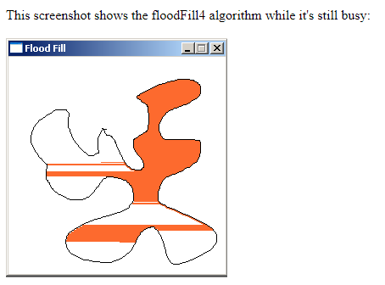

Slide 10

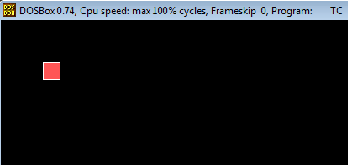
Output of program with floodfill half way and full way

Slide 11
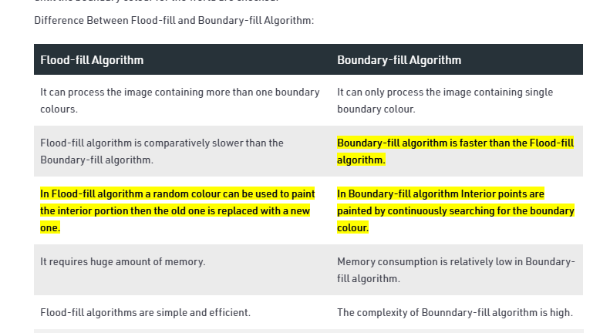

Slide 12
Ref video for explanation
https://youtu.be/au2CslPa4xU
boundary fill algorithm in computer graphics mumbai university(google search)
flood fill algorithm in computer graphics mumbai university(google search)

